Slide 1

INTRODUCING
BY
ALEXANDRA / NHL STENDEN
GUILHERME / IPCA
ARMANDO / BURGOS

Slide 2
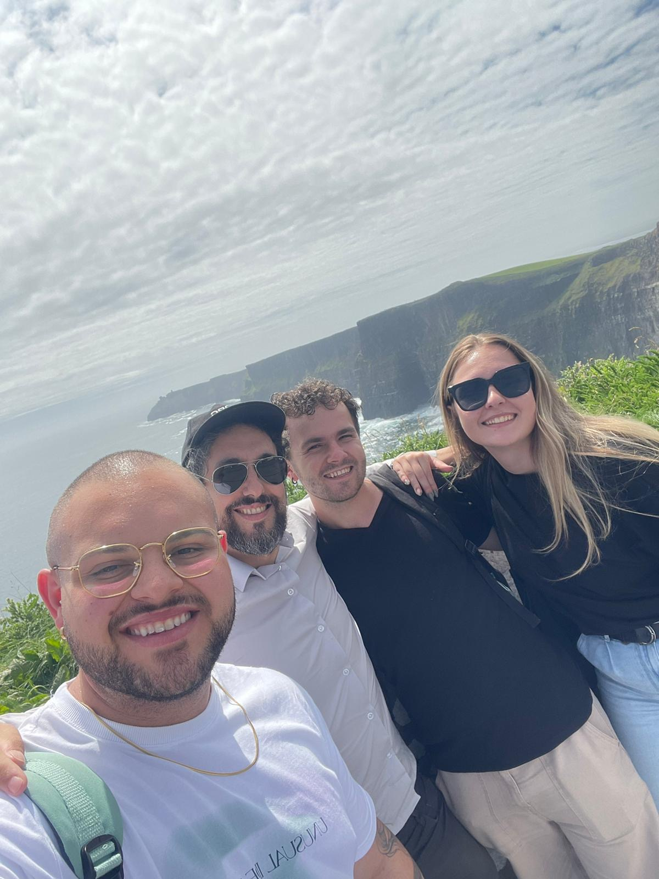

WHO ARE WE?
alexandra
Guilherme / IPCA
📍 Brazil
📚 Computer System Engineering
SUSPENDED
armando
guilherme
Armando / BURGOS
📍 Venezuela
📚 Computer Engineering
Alexandra / NHL STENDEN
📍 Slovakia
📚 Communication and Multimedia Design

Slide 3
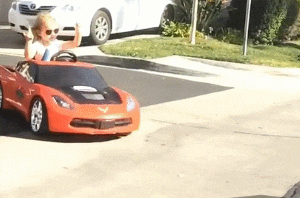
PROJECT
FIRST IDEA
At the beginning of the game user would have to insert their name to remember their score in the text file
Game would load the best score
The goal of the game is for user to stay on the squiggly road as long as possible
As the game advances, the car is accelerating

Slide 4
PROJECT
MOTIVATION
Guilherme: “I am a guy who likes to play games and I never got the opportunity to make one myself. So, I used this SAP as chance to make one.”
Alexandra: ”Working on this project gave me opportunity to connect Multimedia Design with Programming. It was nice experience to come up with the idea and to not only visualise the concept but making it work.”
Armando: ”Doing something easy and quick.”

Slide 5
PROJECT
CONCEPT
Concept created using tkinter library
Not so responsive
Bigger risk of bugs and loading failure
Not so visually pleasing
PYGAME

Slide 6
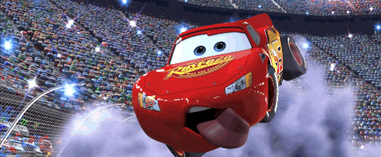
PROJECT
DESCRIPTION
At the beginning of the game user would have to insert their name to remember their score in the text file
The game remembers the highest achieved score during playtime and 4 best scores on main screen
The goal of the game is for user to outdrive every obstacle
As the game advances, the car is accelerating
User can choose from 5 cars

Slide 7
TASK DIVISION
ALEXANDRA
Programming the concept
Editing visuals
Presentations
GUILHEMRE
Saving and generating data
ARMANDO
Programming the movement

Slide 8
SO WHAT ABOUT THE CODE?

Slide 9
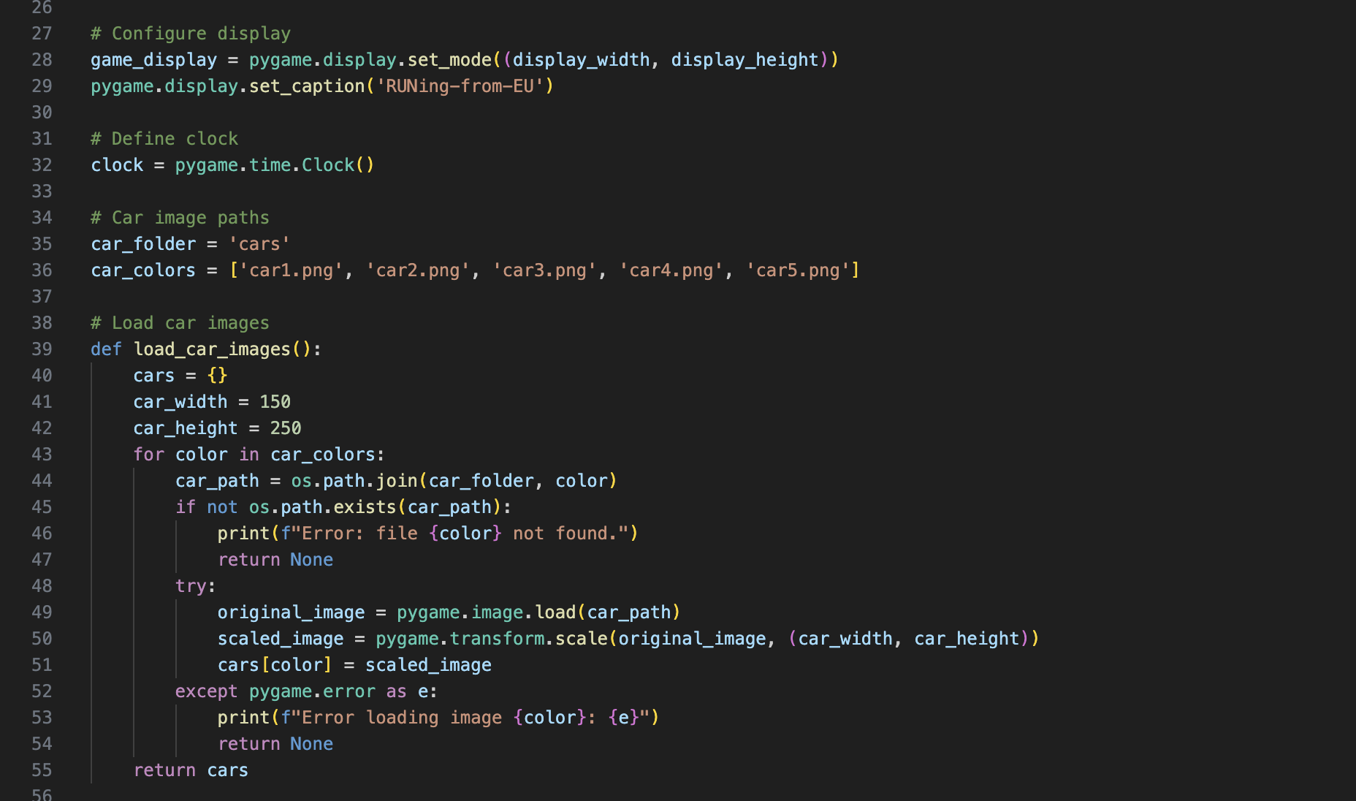

Slide 10
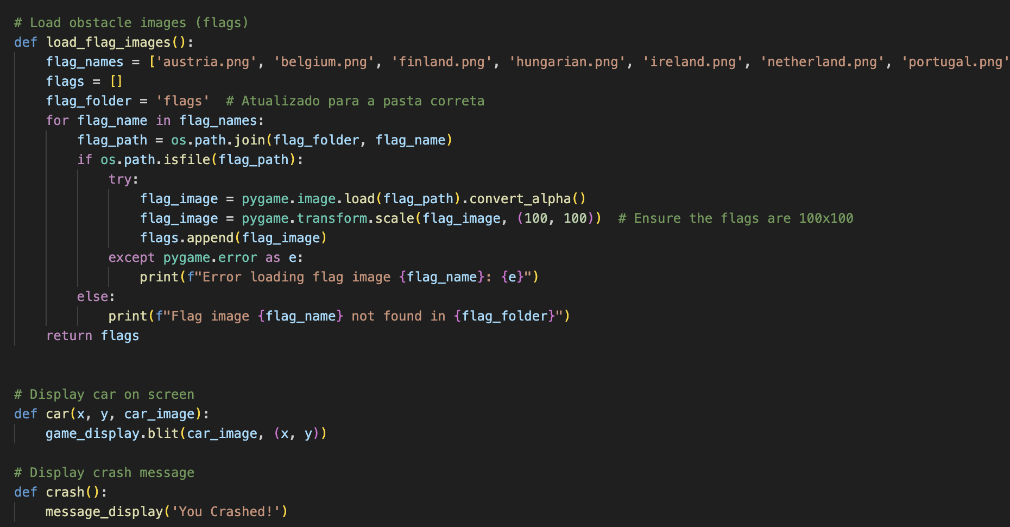

Slide 11
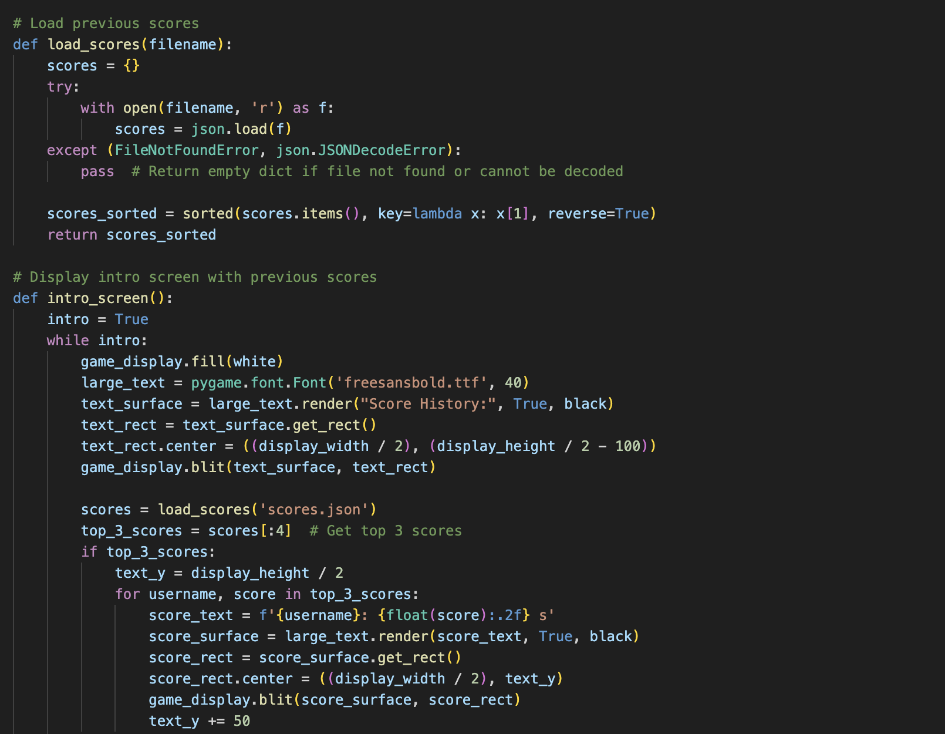
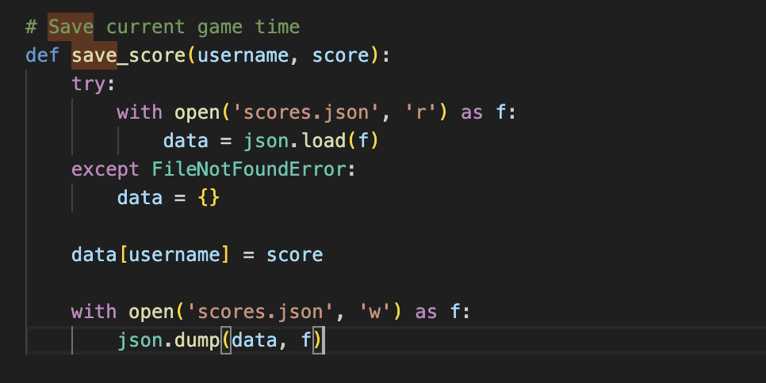

Slide 12
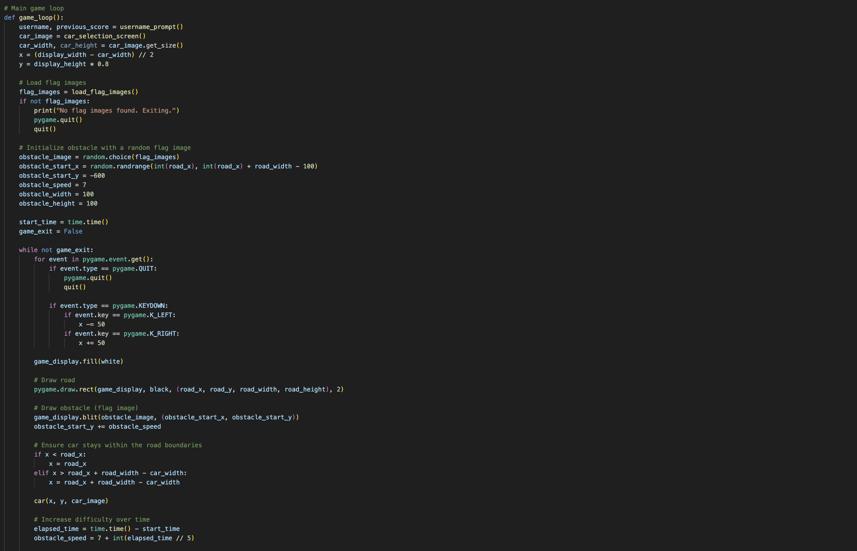

Slide 13
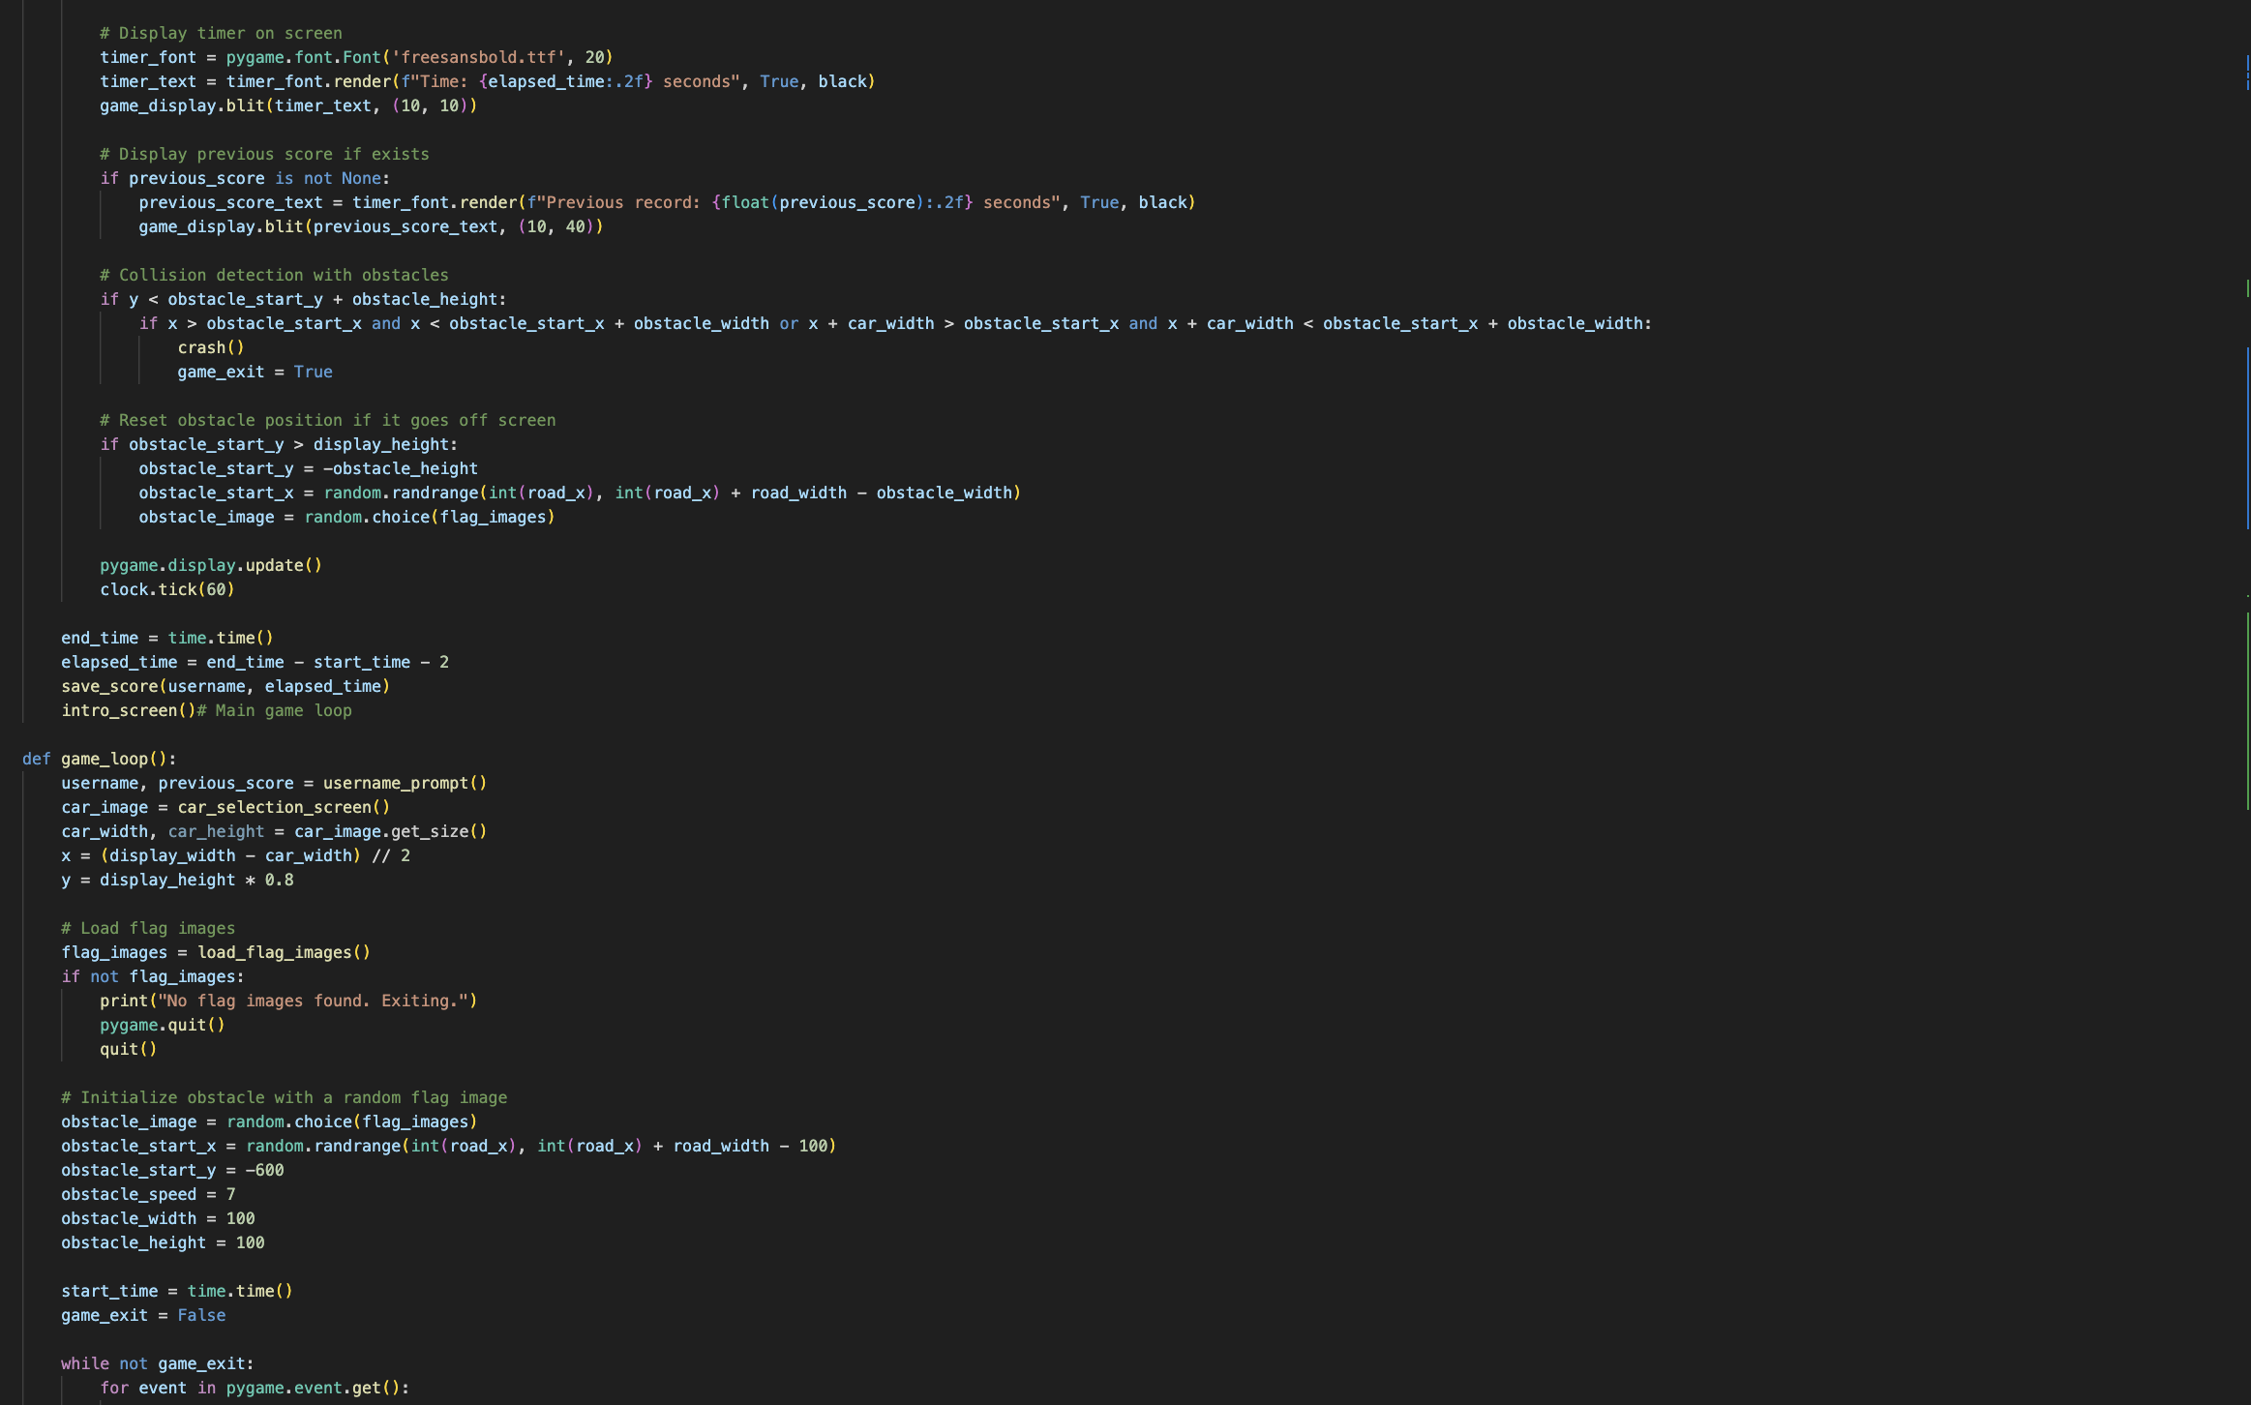

Slide 14
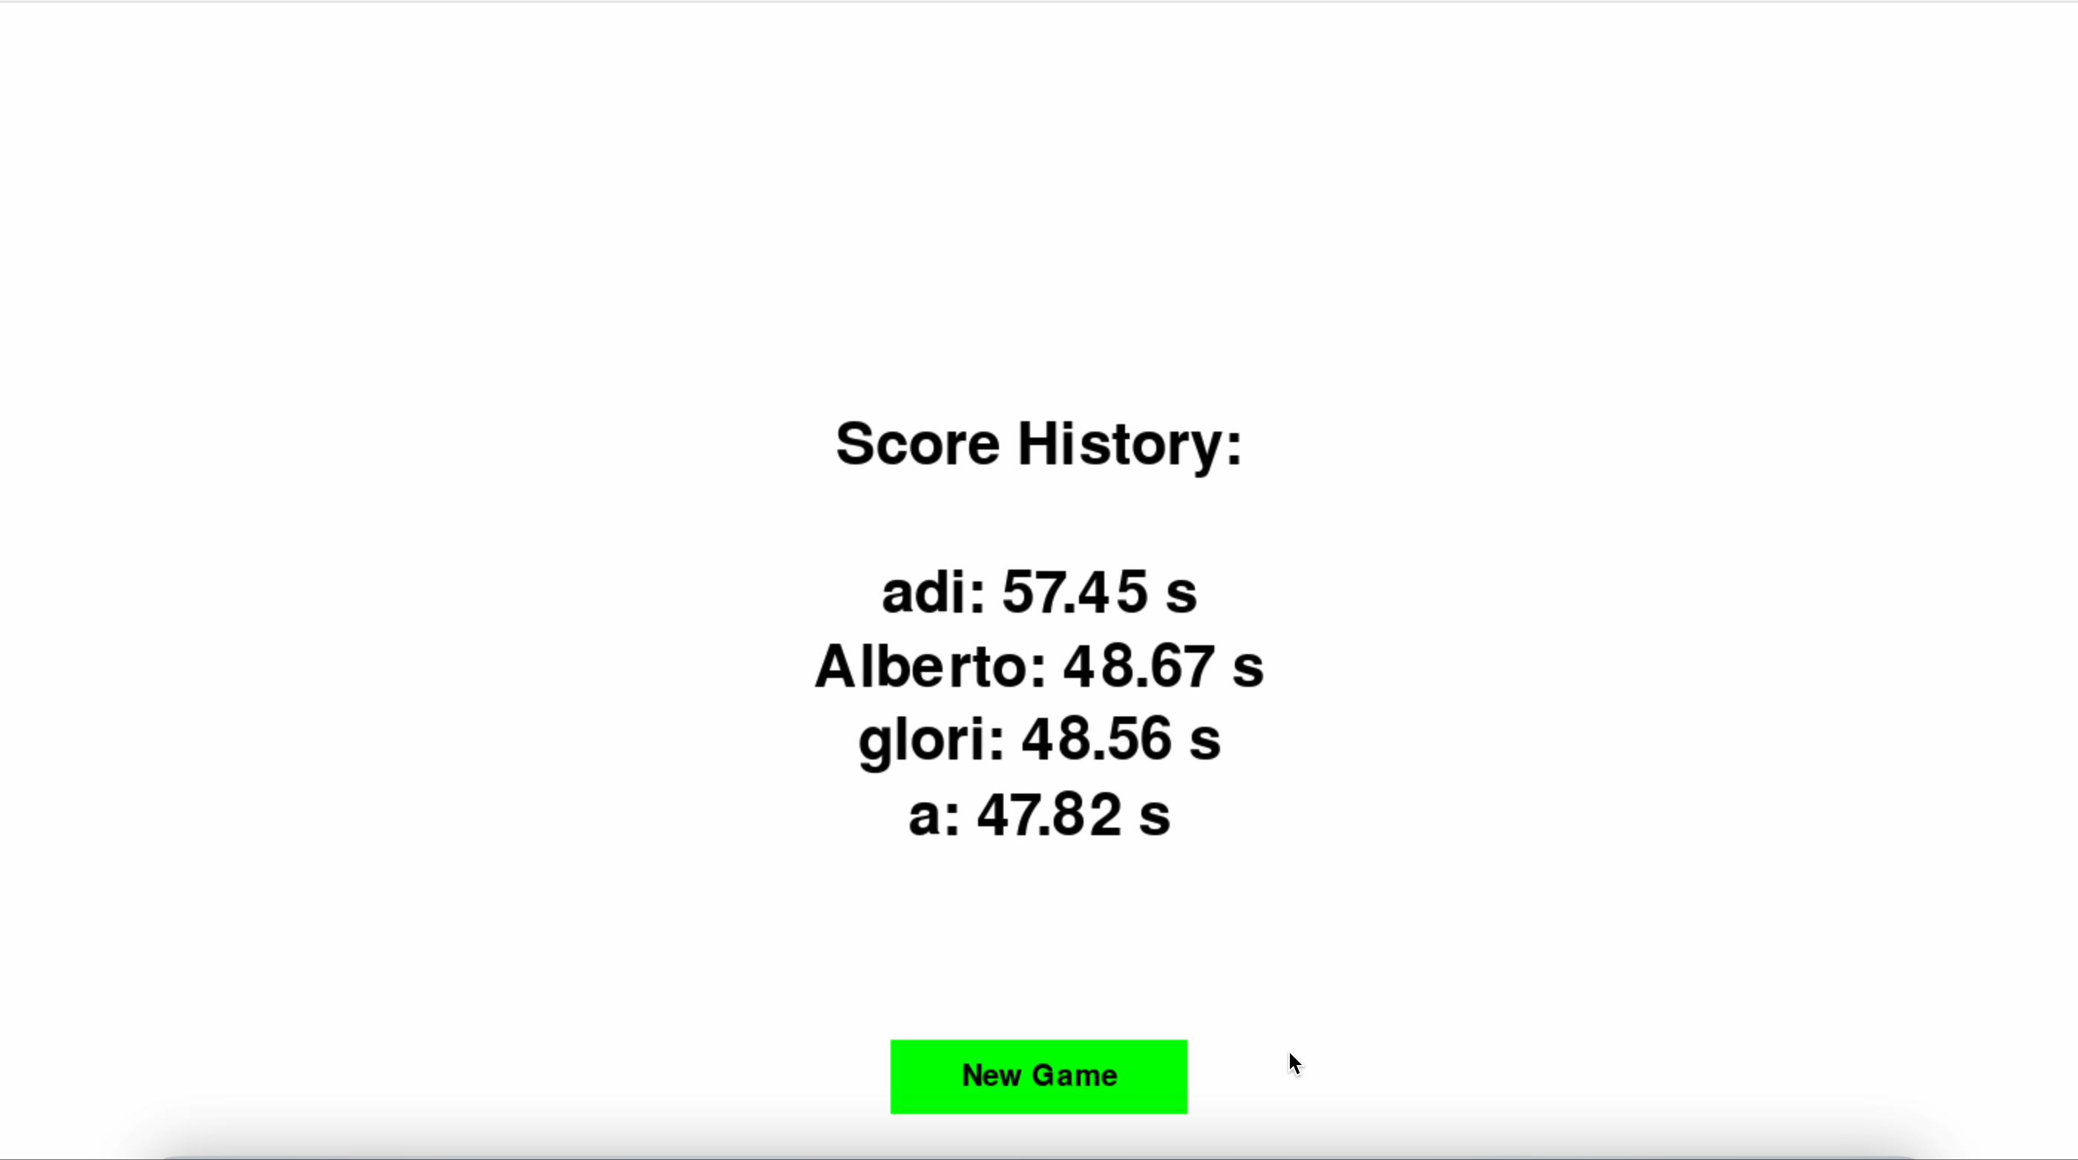

Slide 15
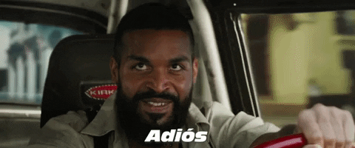
LOADED 100%...
TO BE CONTINUED
ALEXANDRA / NHL STENDEN
GUILHERME / IPCA
ARMANDO / BURGOS

